Slide 1
SPRINT CYCLE III
Xpression
Database implementation
The MySQL database for pieces, invitations, and reports.
MySQL · database xpression
James Henson
Clemenceau Senatus
Leeyand Blot Jr
Jacob Fitchett
Scrum Master
github.com/Jvmes3/Xpression_ISProject
Notes:
Open MySQL on the xpression database before you start. The steps in README.md are the commands. The slides follow the order to say.

Slide 2
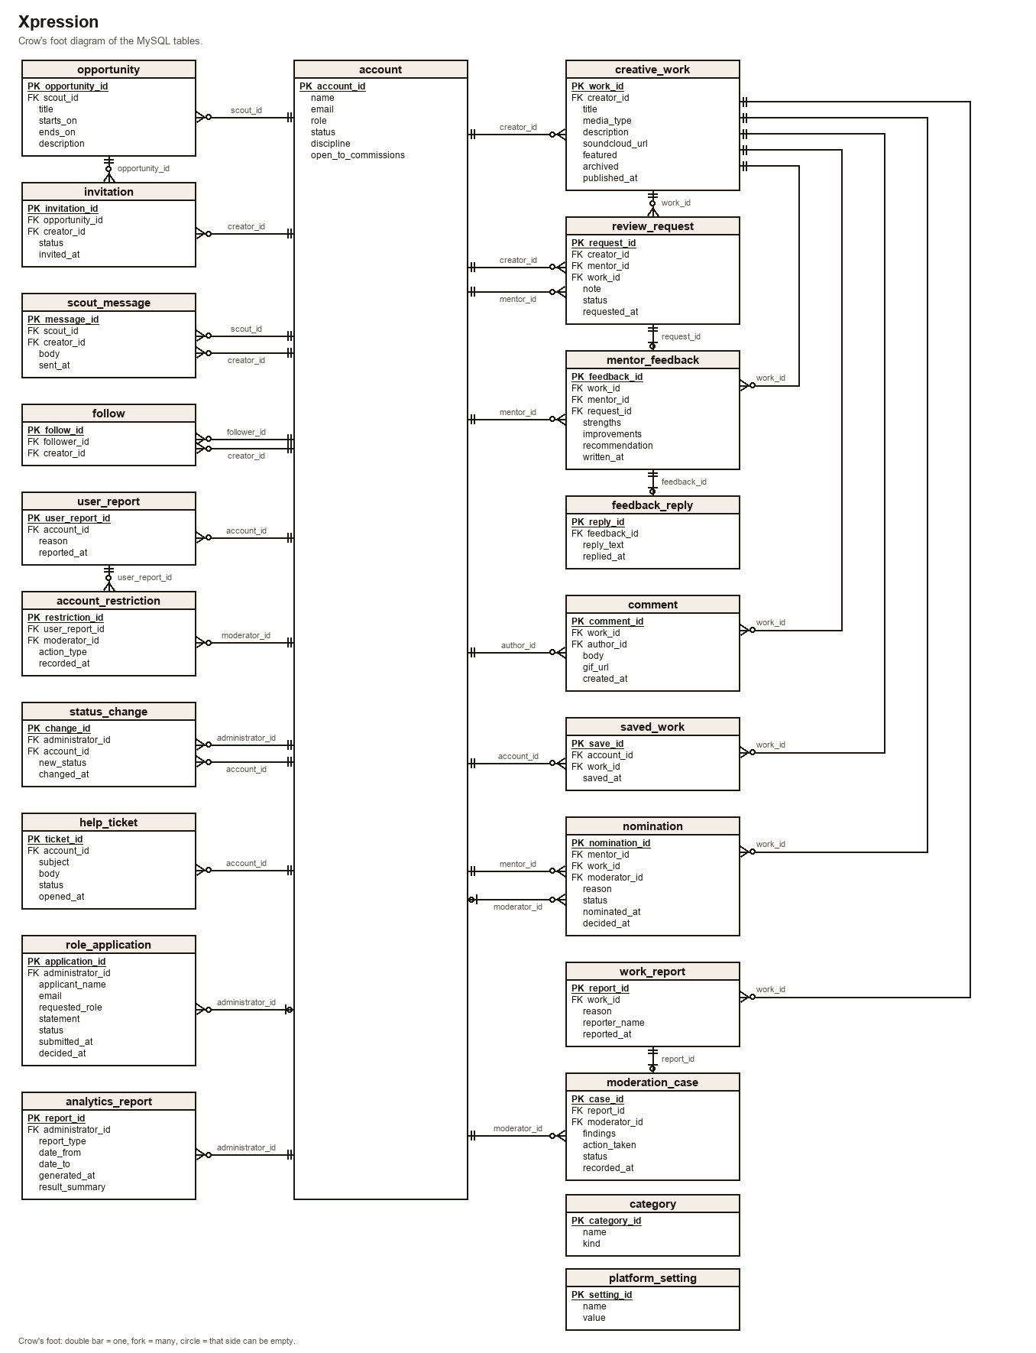
THE DIAGRAM
Account in the center
Pieces, invitations, reports, feedback, and comments connect to the person they belong to.
creative_work
Each published piece.
invitation
An opportunity joined to one creator.
moderation_case
The decision on a work report.
Xpression · Sprint Cycle III
2
Notes:
Account is the center table. The other tables connect to it.

Slide 3
THE TABLES
xpression
USE xpression;
SHOW TABLES;
account
One person, one role.
review_request
A request for a mentor to review a piece.
creative_work
A published piece.
mentor_feedback
The mentor's notes on that piece.
opportunity
A call from a talent scout.
comment
A comment on a piece.
invitation
One creator invited to one opportunity.
follow
One account following one creator.
work_report
A report on a piece.
saved_work
A piece an account saved.
moderation_case
The decision on one report.
role_application
A request for Mentor or Talent Scout.
Xpression · Sprint Cycle III
3
Notes:
Twenty-two tables. These are the ones the walkthrough uses.

Slide 4
ACCOUNT
The people
Creators
Amara Cole, Luis Ortega, Nia Brooks, Jordan Lee
SELECT name, role, discipline
FROM account
ORDER BY account_id;
SELECT creator_name, title,
media_type, featured
FROM creator_portfolio
ORDER BY published_at;
Mentor
Elena Voss
Talent Scout
Marcus Hale
Moderator
Priya Shah
Administrator
Ada Lowe
No account yet
Maya Chen, pending mentor application
Jordan's status is suspended.
Harbor demo has a SoundCloud URL because it is music. The writing and the painting do not.
Xpression · Sprint Cycle III
4
Notes:
Run both selects. Walk the names and roles. Mention Harbor demo only if they ask why one row has a SoundCloud URL.

Slide 5
CREATOR_PORTFOLIO
Amara Cole's pieces
SELECT title, media_type, featured, published_at
FROM creator_portfolio
WHERE creator_name = 'Amara Cole'
ORDER BY published_at;
Night bus and Last light on the platform.
Xpression · Sprint Cycle III
5
Notes:
Both pieces are writing. Platform notes is not in this result.

Slide 6
INVITATION
Winter listening night
SELECT o.title AS opportunity, a.name AS creator, i.status, i.invited_at
FROM invitation AS i
JOIN opportunity AS o ON o.opportunity_id = i.opportunity_id
JOIN account AS a ON a.account_id = i.creator_id
WHERE o.title = 'Winter listening night'
ORDER BY i.invited_at;
Nia Brooks was sent an invitation. Amara Cole accepted hers.
Xpression · Sprint Cycle III
6
Notes:
Invitation joins the opportunity to the creator.

Slide 7
CREATIVE_WORK
Platform notes
SELECT a.name, w.title, w.media_type, w.published_at
FROM creative_work AS w
JOIN account AS a ON a.account_id = w.creator_id
WHERE w.title = 'Platform notes';
A writing piece by Amara Cole.
Xpression · Sprint Cycle III
7
Notes:
Inserted by sql/04-changes.sql.

Slide 8
CREATIVE_WORK
Night bus
SELECT work_id, title, featured
FROM creative_work
WHERE title = 'Night bus';
UPDATE creative_work
SET featured = TRUE
WHERE title = 'Night bus';
The same work id. Featured changes from false to true.
Xpression · Sprint Cycle III
8
Notes:
The second select is the same statement, after the update.

Slide 9
INVITATION
Riverfront mural call
SELECT s.name AS scout, o.title, c.name AS creator, i.status
FROM invitation AS i
JOIN opportunity AS o ON o.opportunity_id = i.opportunity_id
JOIN account AS s ON s.account_id = o.scout_id
JOIN account AS c ON c.account_id = i.creator_id
WHERE o.title = 'Riverfront mural call';
Marcus Hale invited Luis Ortega. One invitation for that pair.
Xpression · Sprint Cycle III
9
Notes:
The same creator is not invited to this opportunity again. Winter listening night has two creators.

Slide 10
REPORTED_WORK
Studio wall study
SELECT title, reason, reporter_name, findings,
action_taken, case_status, moderator_name
FROM reported_work
WHERE title = 'Studio wall study';
Two reports. Priya Shah kept both available and closed both cases.
Xpression · Sprint Cycle III
10
Notes:
Each report has one moderation case.

Slide 11
SQL/05-RULES.SQL
Rejected rows
These inserts are refused. The tables stay as they are.
1
An email is unique.
A second account cannot use amara.cole@xpression.example.
2
A piece must belong to a Creator.
Marcus Hale is a Talent Scout, so a piece cannot be stored on his account.
3
One creator, one invitation.
Luis cannot be invited to the mural call again.
Xpression · Sprint Cycle III
11
Notes:
If there is time: a music piece must have a SoundCloud URL, and one report opens only one case. Feedback is stored only when the review request is accepted. Only an administrator can change an account status. Priya can refer Jordan Lee for a ban. Ada Lowe sets his status to suspended.

Slide 12
REPOSITORY
Sprint Cycle III
github.com/Jvmes3/Xpression_ISProject
SQL scripts, the diagram, the data dictionary, and the business rules.
Notes:
Leave the repository URL up while you take questions.

